Slide 1

Code Smells

Slide 2
What Are Code Smells?
Code smells are signs that your code is not as clean and maintainable as it could be. They often result from poor design patterns or excessive complexity, even if the code is syntactically correct.
Categories
  Dispensable: Something pointless and unneeded whose absence would make the code cleaner, more efficient and easier to understand.

Slide 3
Category: Bloaters
Bloaters are code, methods and classes that have increased to such gargantuan proportions that they’re hard to work with.
Usually, these smells don’t crop up right away, rather they accumulate over time as the program evolves (and especially when nobody makes an effort to eradicate them)
Smells
  Long Method: A method contains too many lines of code. Generally, any method longer than ten lines should make you start asking questions.
  Large Class: A class contains many fields/methods/lines of code.
  Primitive Obsession:
    Use of primitives instead of small objects for simple tasks (such as currency, ranges, special strings for phone numbers, etc.)
    Use of constants for coding information (such as a constant USER_ADMIN_ROLE = 1 for referring to users with administrator rights.)
    Use of string constants as field names for use in data arrays
  Long Parameter List: More than three or four parameters for a method.
  Data Clumps: Sometimes different parts of the code contain identical groups of variables (such as parameters for connecting to a database). These clumps should be turned into their own classes.

Slide 4
Category: Object-Orientation Abusers
All these smells are incomplete or incorrect application of object-oriented programming principles.
Smells
  Switch Statements: You have a complex switch operator or sequence of if statements.
  Temporary Field: Temporary fields get their values (and thus are needed by objects) only under certain circumstances. Outside of these circumstances, they’re empty.
  Refused Bequest: If a subclass uses only some of the methods and properties inherited from its parents, the hierarchy is off-kilter. The unneeded methods may simply go unused or be redefined and give off exceptions.
  Alternative Classes with Different Interfaces: Two classes perform identical functions but have different method names.

Slide 5
Category: Change Preventers
These smells mean that if you need to change something in one place in your code, you have to make many changes in other places too. Program development becomes much more complicated and expensive as a result.
Smells
  Divergent Change: You find yourself having to change many unrelated methods when you make changes to a class. For example, when adding a new product type you must change the methods for finding, displaying, and ordering products.
  Shotgun Surgery: Making any modifications requires that you make many small changes to many different classes.
  Parallel Inheritance Hierarchies: Whenever you create a subclass for a class, you find yourself needing to create a subclass for another class.

Slide 6
Category: Dispensable
A dispensable is something pointless and unneeded whose absence would make the code cleaner, more efficient and easier to understand.
Smells
  Comments: A method is filled with explanatory comments.
  Duplicate Code: Two code fragments look almost identical.
  Lazy Class: Understanding and maintaining classes always costs time and money. So, if a class doesn’t do enough to earn your attention, it should be deleted.
  Data Class: A data class refers to a class that contains only fields and crude methods for accessing them (getters and setters). These are simply containers for data used by other classes. These classes don’t contain any additional functionality and can’t independently operate on the data that they own.
  Dead Code: A variable, parameter, field, method or class is no longer used (usually because it’s obsolete).
  Speculative Generality: There’s an unused class, method, field or parameter..

Slide 7
Category: Couplers
All the smells in this group contribute to excessive coupling between classes or show what happens if coupling is replaced by excessive delegation.
Smells
  Feature Envy: A method accesses the data of another object more than its own data.
  Inappropriate Intimacy: One class uses the internal fields and methods of another class.
  Message Chains: In code you see a series of calls resembling $a->b()->c()->d()
  Middle Man: If a class performs only one action, delegating work to another class, why does it exist at all?

Slide 8
Category: Other
Below are the smells which don’t fall into any broad category.
Smells
  Incomplete Library Class: Sooner or later, libraries stop meeting user needs. The only solution to the problem—changing the library—is often impossible since the library is read-only.

Slide 9
Smells
Bloaters
Change Preventers
Divergent Change
OO Abusers
Long Method
Large Class
Primitive Obsession
Long Parameter List
Data Clumps
Switch Statements
Temporary Field
Refused Bequest
Alternative Classes with Different Interfaces
Shotgun Surgery
Parallel Inheritance Hierarchies
Dispensables
Comments
Duplicate Code
Lazy Class
Data Class
Dead Code
Speculative Generality
Couplers
Feature Envy
Inappropriate Intimacy
Message Chains
Middle Man
Others
Incomplete Library Class

Slide 10
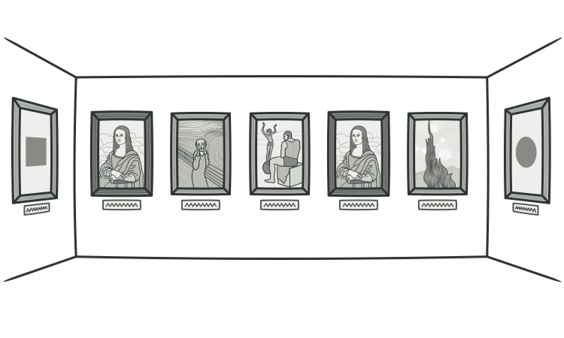
Duplicated code
Signs and Symptoms
  Two code fragments look almost identical.
Reasons for the Problem
  Duplication usually occurs when multiple programmers are working on different parts of the same program at the same time. Since they’re working on different tasks, they may be unaware their colleague has already written similar code that could be repurposed for their own needs.
  There’s also more subtle duplication, when specific parts of code look different but actually perform the same job. This kind of duplication can be hard to find and fix.
  Sometimes duplication is purposeful. When rushing to meet deadlines and the existing code is “almost right” for the job, novice programmers may not be able to resist the temptation of copying and pasting the relevant code. And in some cases, the programmer is simply too lazy to de-clutter.

Slide 11
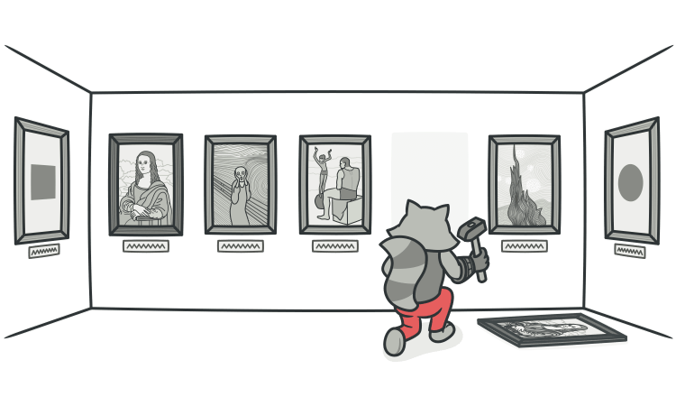
Duplicated code
Treatment
  If the same code is found in two or more methods in the same class: use Extract Method and place calls for the new method in both places.

Slide 12
Duplicated code
If the same code is found in two subclasses of the same level:
  Use Extract Method for both classes, followed by Pull Up Field for the fields used in the method that you’re pulling up.
  If the duplicate code is inside a constructor, use Pull Up Constructor Body.
  If the duplicate code is similar but not completely identical, use Form Template Method.
  If two methods do the same thing but use different algorithms, select the best algorithm and apply Substitute Algorithm.

Slide 13
Duplicated code
If duplicate code is found in two different classes:
  If the classes aren’t part of a hierarchy, use Extract Superclass in order to create a single superclass for these classes that maintains all the previous functionality.
  If it’s difficult or impossible to create a superclass, use Extract Class in one class and use the new component in the other.
If a large number of conditional expressions are present and perform the same code (differing only in their conditions)
  merge these operators into a single condition using Consolidate Conditional Expression and use Extract Method to place the condition in a separate method with an easy-to-understand name.
If the same code is performed in all branches of a conditional expression:
  place the identical code outside of the condition tree by using Consolidate Duplicate Conditional Fragments.

Slide 14
Duplicated code
Payoff:
  Merging duplicate code simplifies the structure of your code and makes it shorter.
  Simplification + shortness = code that’s easier to simplify and cheaper to support.
When to Ignore
  In very rare cases, merging two identical fragments of code can make the code less intuitive and obvious.

Slide 15

Long methods
Signs and Symptoms
  A method contains too many lines of code. Generally, any method longer than ten lines should make you start asking questions.
Reasons for the Problem
  Like the Hotel California, something is always being added to a method but nothing is ever taken out. Since it’s easier to write code than to read it, this “smell” remains unnoticed until the method turns into an ugly, oversized beast.
  Mentally, it’s often harder to create a new method than to add to an existing one: “But it’s just two lines, there’s no use in creating a whole method just for that...” Which means that another line is added and then yet another, giving birth to a tangle of spaghetti code.

Slide 16
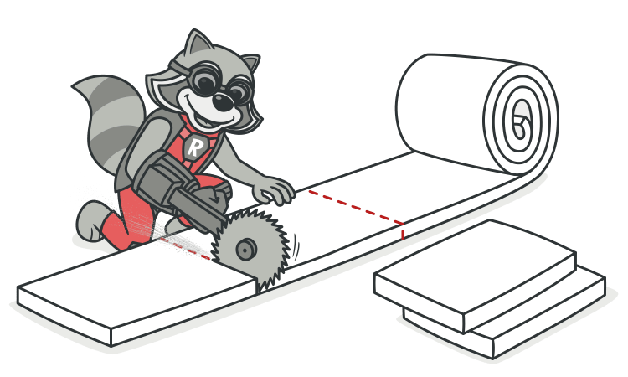
Long Methods
Treatment
  As a rule of thumb, if you feel the need to comment on something inside a method, you should take this code and put it in a new method. Even a single line can and should be split off into a separate method, if it requires explanations. And if the method has a descriptive name, nobody will need to look at the code to see what it does.

Slide 17
Long Methods
Treatment
  To reduce the length of a method body, use Extract Method.
  If local variables and parameters interfere with extracting a method, use Replace Temp with Query, Introduce Parameter Object or Preserve Whole Object.
  If none of the previous recipes help, try moving the entire method to a separate object via Replace Method with Method Object.
  Conditional operators and loops are a good clue that code can be moved to a separate method. For conditionals, use Decompose Conditional. If loops are in the way, try Extract Method.

Slide 18
Long Methods
Payoff
  Among all types of object-oriented code, classes with short methods live longest. The longer a method or function is, the harder it becomes to understand and maintain it.
  In addition, long methods offer the perfect hiding place for unwanted duplicate code.
Performance
  Does an increase in the number of methods hurt performance, as many people claim? In almost all cases the impact is so negligible that it’s not even worth worrying about.
  Plus, now that you have clear and understandable code, you’re more likely to find truly effective methods for restructuring code and getting real performance gains if the need ever arises.

Slide 19
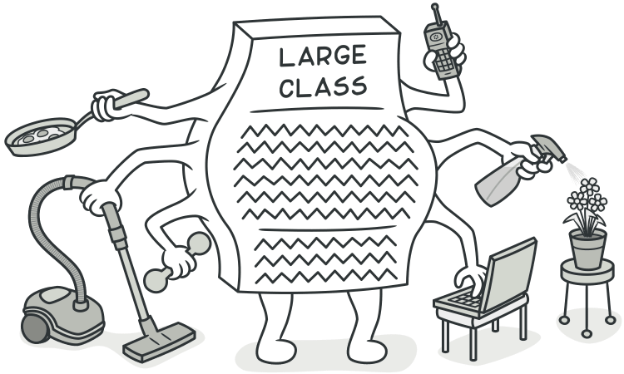
Large classes
Signs and Symptoms
  A class contains many fields/methods/lines of code.

Slide 20
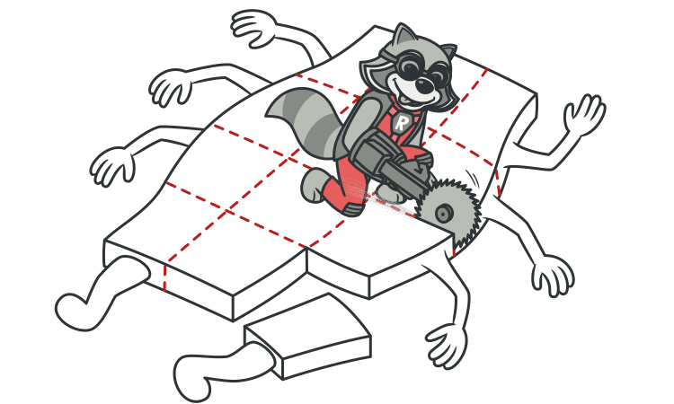
Large classes
Reasons for the Problem
  Classes usually start small. But over time, they get bloated as the program grows.
  As is the case with long methods as well, programmers usually find it mentally less taxing to place a new feature in an existing class than to create a new class for the feature.

Slide 21
Large classes
Treatment
  When a class is wearing too many (functional) hats, think about splitting it up:
    Extract Class helps if part of the behavior of the large class can be spun off into a separate component.
    Extract Subclass helps if part of the behavior of the large class can be implemented in different ways or is used in rare cases.
    Extract Interface helps if it’s necessary to have a list of the operations and behaviors that the client can use.
    If a large class is responsible for the graphical interface, you may try to move some of its data and behavior to a separate domain object. In doing so, it may be necessary to store copies of some data in two places and keep the data consistent. Duplicate Observed Data offers a way to do this.

Slide 22
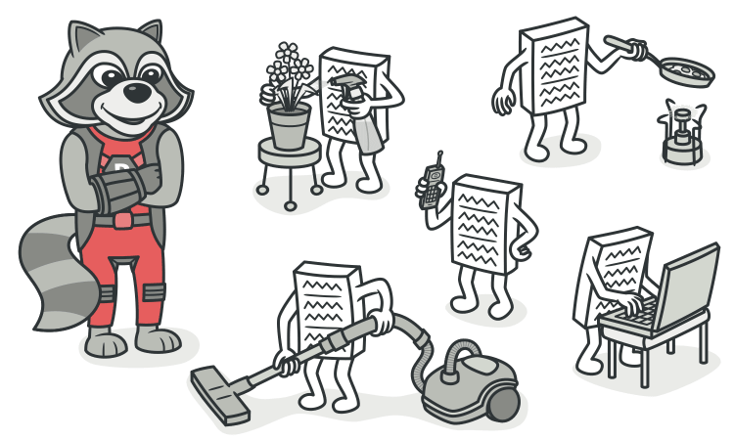
Large classes
Payoff
  Refactoring of these classes spares developers from needing to remember a large number of attributes for a class.
  In many cases, splitting large classes into parts avoids duplication of code and functionality

Slide 23
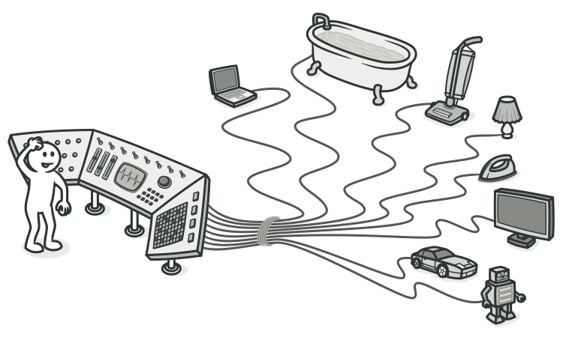
Switch Statements
Signs and Symptoms
  You have a complex switch operator or sequence of if statements.

Slide 24
Switch Statements
Reasons for the Problem
  Relatively rare use of switch and case operators is one of the hallmarks of object-oriented code. Often code for a single switch can be scattered in different places in the program. When a new condition is added, you have to find all the switch code and modify it.
  As a rule of thumb, when you see switch you should think of polymorphism.

Slide 25
Switch Statements
Treatment
  To isolate switch and put it in the right class, you may need Extract Method and then Move Method.
  If a switch is based on type code, such as when the program’s runtime mode is switched, use Replace Type Code with Subclasses or Replace Type Code with State/Strategy.
  After specifying the inheritance structure, use Replace Conditional with Polymorphism.
  If there aren’t too many conditions in the operator and they all call same method with different parameters, polymorphism will be superfluous. If this case, you can break that method into multiple smaller methods with Replace Parameter with Explicit Methods and change the switch accordingly.
  If one of the conditional options is null, use Introduce Null Object.

Slide 26
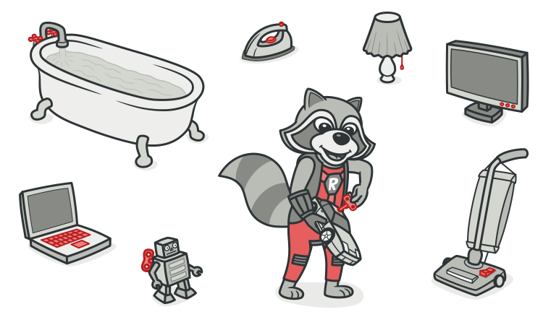
Switch Statements
Payoff
  Improved code organization.
When to Ignore
  When a switch operator performs simple actions, there’s no reason to make code changes.
  Often switch operators are used by factory design patterns (Factory Method or Abstract Factory) to select a created class.

Slide 27
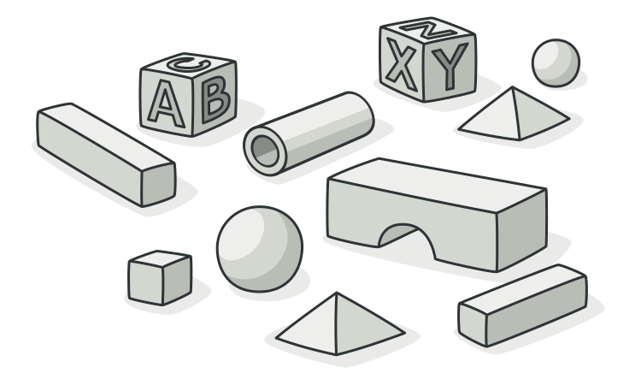
Primitive Obsession
Signs and Symptoms
  Use of primitives instead of small objects for simple tasks (such as currency, ranges, special strings for phone numbers, etc.)
  Use of constants for coding information (such as a constant USER_ADMIN_ROLE = 1 for referring to users with administrator rights.)
  Use of string constants as field names for use in data arrays.

Slide 28
Primitive Obsession
Reasons for the Problem
  Like most other smells, primitive obsessions are born in moments of weakness. “Just a field for storing some data!” the programmer said. Creating a primitive field is so much easier than making a whole new class, right? And so, it was done. Then another field was needed and added in the same way. Lo and behold, the class became huge and unwieldy.
  Primitives are often used to “simulate” types. So instead of a separate data type, you have a set of numbers or strings that form the list of allowable values for some entity. Easy-to-understand names are then given to these specific numbers and strings via constants, which is why they’re spread wide and far.
  Another example of poor primitive use is field simulation. The class contains a large array of diverse data and string constants (which are specified in the class) are used as array indices for getting this data.

Slide 29
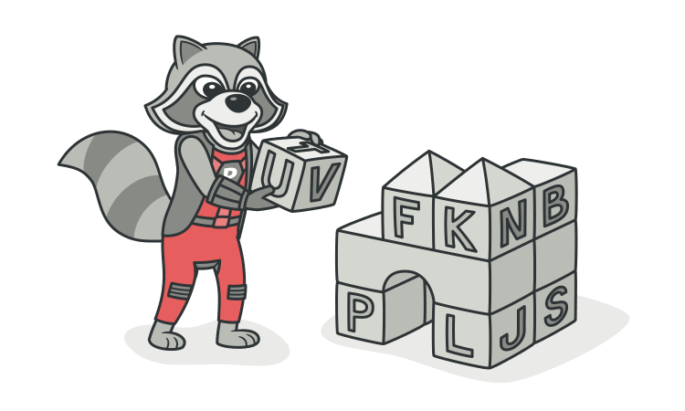
Primitive Obsession
Treatment
  If you have a large variety of primitive fields, it may be possible to logically group some of them into their own class. Even better, move the behavior associated with this data into the class too. For this task, try Replace Data Value with Object.
  If the values of primitive fields are used in method parameters, go with Introduce Parameter Object or Preserve Whole Object.
  When complicated data is coded in variables, use Replace Type Code with Class, Replace Type Code with Subclasses or Replace Type Code with State/Strategy.
  If there are arrays among the variables, use Replace Array with Object.

Slide 30
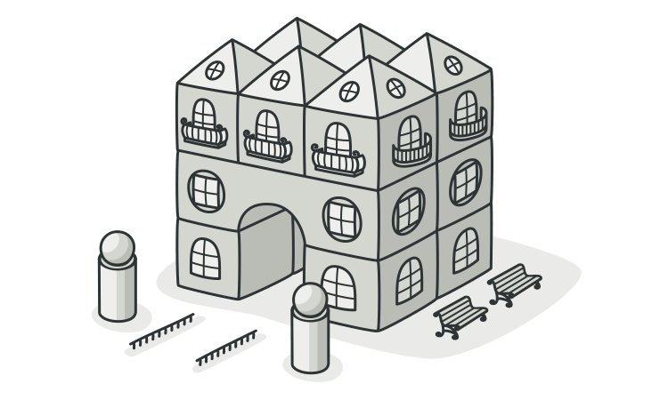
Primitive Obsession
Payoff
  Code becomes more flexible thanks to use of objects instead of primitives.
  Better understandability and organization of code. Operations on particular data are in the same place, instead of being scattered. No more guessing about the reason for all these strange constants and why they’re in an array.
  Easier finding of duplicate code.

Slide 31
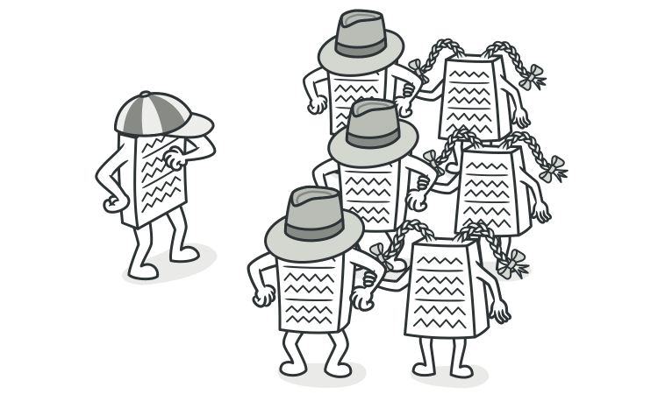
Middle man
Signs and Symptoms
  If a class performs only one action, delegating work to another class, why does it exist at all?
Reasons for the Problem
  This smell can be the result of overzealous elimination of Message Chains.
  In other cases, it can be the result of the useful work of a class being gradually moved to other classes. The class remains as an empty shell that doesn’t do anything other than delegate.

Slide 32
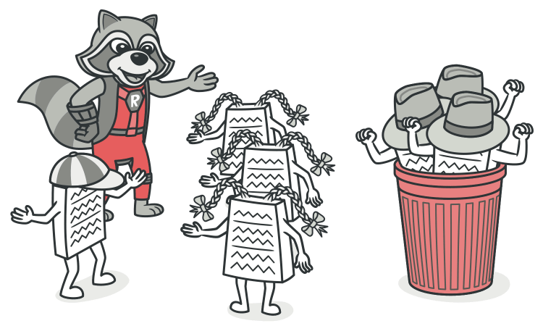
Middle man
Treatment
  If most of a method’s classes delegate to another class, Remove Middle Man is in order.
Payoff
  Less bulky code.
When to Ignore
  Don’t delete middle man that have been created for a reason:
    A middle man may have been added to avoid interclass dependencies.
    Some design patterns create middle man on purpose (such as Proxy or Decorator).

Slide 33
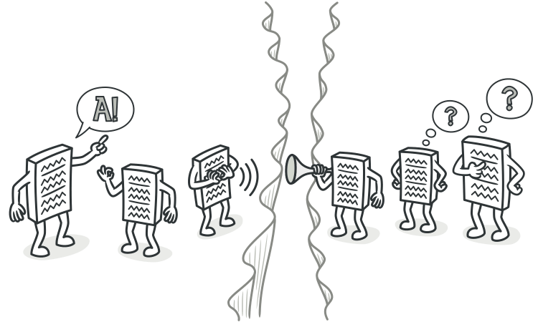
Message Chains
Signs and Symptoms
  In code you see a series of calls resembling $a->b()->c()->d()
Reasons for the Problem
  A message chain occurs when a client requests another object, that object requests yet another one, and so on. These chains mean that the client is dependent on navigation along the class structure. Any changes in these relationships require modifying the client.

Slide 34
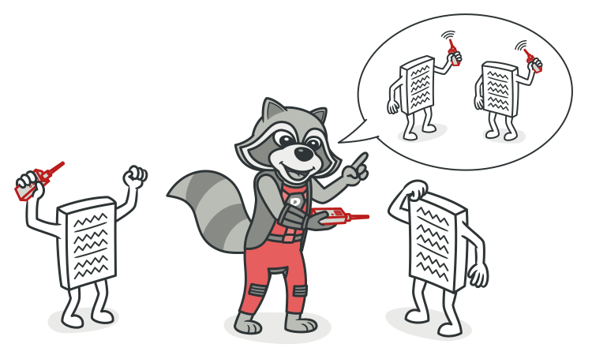
Message Chains
Treatment
  To delete a message chain, use Hide Delegate.
  Sometimes it’s better to think of why the end object is being used. Perhaps it would make sense to use Extract Method for this functionality and move it to the beginning of the chain, by using Move Method.

Slide 35
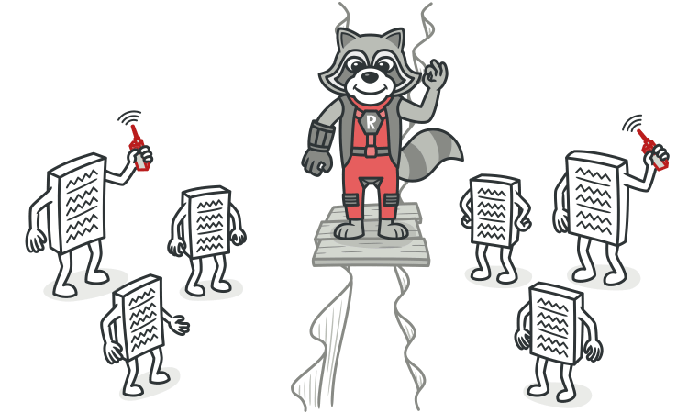
Message Chains
Payoff
  Reduces dependencies between classes of a chain.
  Reduces the amount of bloated code.
When to Ignore
  Overly aggressive delegate hiding can cause code in which it’s hard to see where the functionality is actually occurring. Which is another way of saying, avoid the Middle Man smell as well.

Slide 36
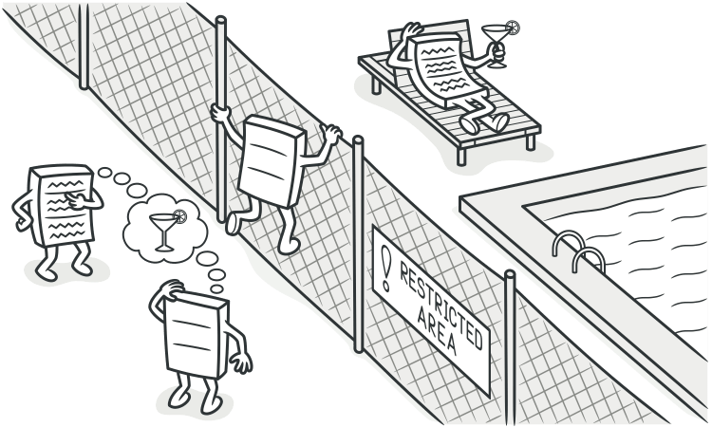
Feature Envy
Signs and Symptoms
  A method accesses the data of another object more than its own data.
Reasons for the Problem
  This smell may occur after fields are moved to a data class. If this is the case, you may want to move the operations on data to this class as well.

Slide 37
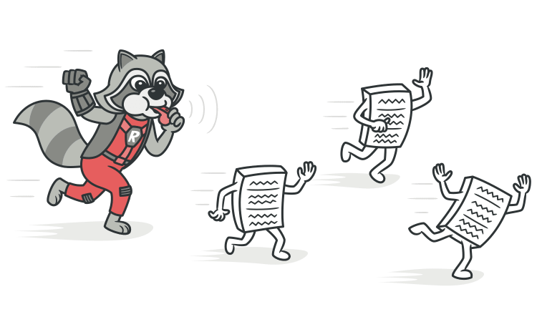
Feature Envy
Treatment
  As a basic rule, if things change at the same time, you should keep them in the same place. Usually, data and functions that use this data are changed together (although exceptions are possible).
    If a method clearly should be moved to another place, use Move Method.
    If only part of a method accesses the data of another object, use Extract Method to move the part in question.
    If a method uses functions from several other classes, first determine which class contains most of the data used. Then place the method in this class along with the other data. Alternatively, use Extract Method to split the method into several parts that can be placed in different places in different classes.

Slide 38
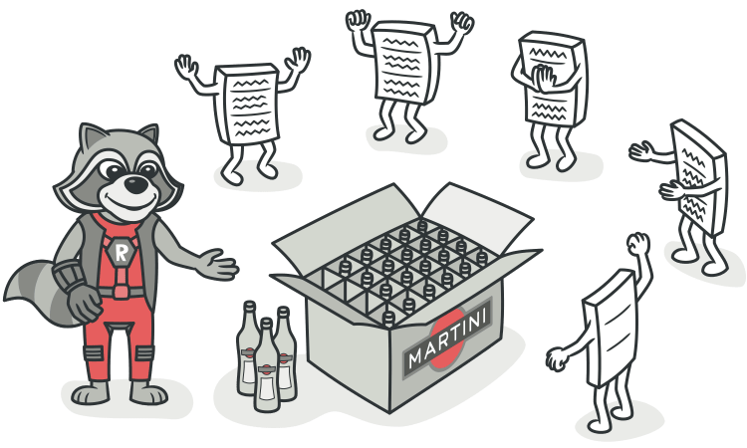
Feature Envy
Payoff
  Less code duplication (if the data handling code is put in a central place).
  Better code organization (methods for handling data are next to the actual data).
When to Ignore
  Sometimes behavior is purposefully kept separate from the class that holds the data. The usual advantage of this is the ability to dynamically change the behavior (see Strategy, Visitor and other patterns).

Slide 39
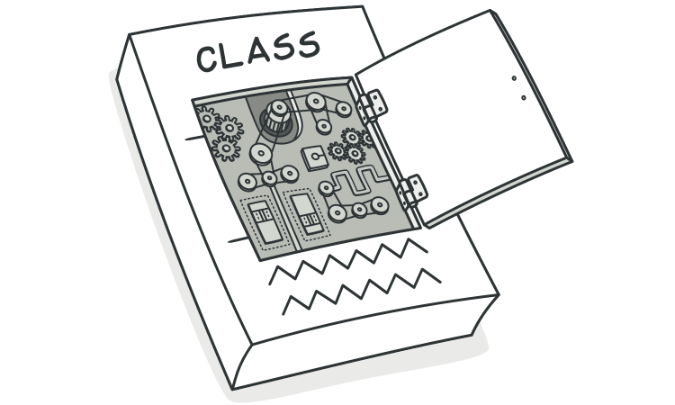
Divergent Change
Signs and Symptoms
  You find yourself having to change many unrelated methods when you make changes to a class. For example, when adding a new product type you have to change the methods for finding, displaying, and ordering products.
Reasons for the Problem
  Often these divergent modifications are due to poor program structure or "copypasta programming”.

Slide 40
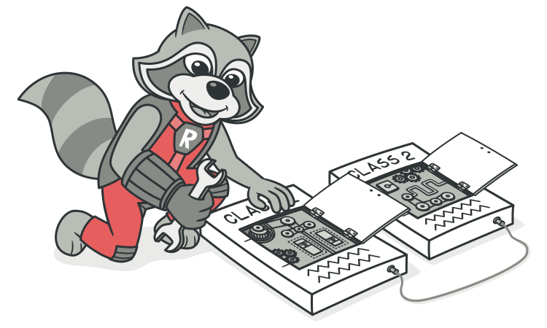
Divergent Change
Treatment
  Split up the behavior of the class via Extract Class.
  If different classes have the same behavior, you may want to combine the classes through inheritance (Extract Superclass and Extract Subclass).
Payoff
  Improves code organization.
  Reduces code duplication.
  Simplifies support.

Slide 41
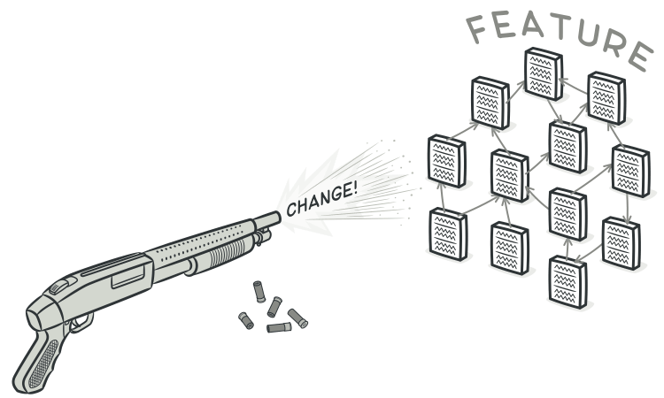
Shotgun Surgery
Signs and Symptoms
  Making any modifications requires that you make many small changes to many different classes.
Reasons for the Problem
  A single responsibility has been split up among a large number of classes. This can happen after overzealous application of Divergent Change.

Slide 42
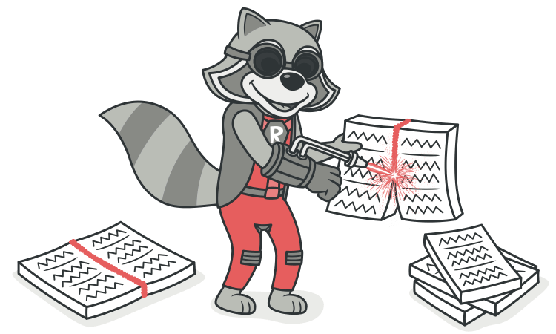
Shotgun Surgery
Treatment
  Use Move Method and Move Field to move existing class behaviors into a single class. If there’s no class appropriate for this, create a new one.
  If moving code to the same class leaves the original classes almost empty, try to get rid of these now-redundant classes via Inline Class.

Slide 43
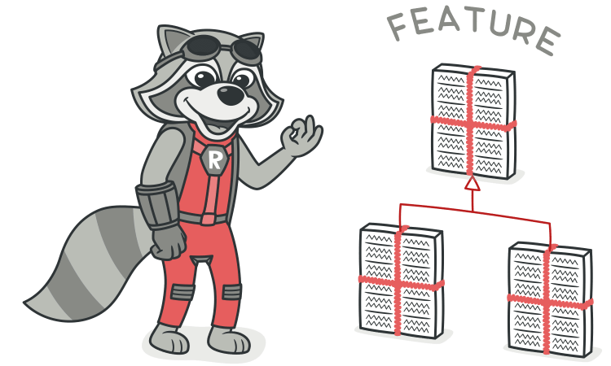
Shotgun Surgery
Payoff
  Better organization.
  Less code duplication.
  Easier maintenance.

Slide 44
God object
Refactoring a "God Class" involves breaking down a large, overly responsible class into smaller, more focused classes, each adhering to the Single Responsibility Principle. This process aims to improve maintainability, testability, and extensibility of the codebase.

Slide 45
God object
Key Steps for Refactoring a God Class:
  Comprehensive Unit Testing: Before initiating any refactoring, establish a robust suite of unit tests for the God class. This ensures that functionality remains intact throughout the refactoring process and provides immediate feedback on any regressions.
  Identify Responsibilities and Dependencies: Analyze the God class to pinpoint distinct responsibilities and identify which methods and attributes are tightly coupled. Look for logical groupings of functionality.
  Extract Classes: Create new classes to encapsulate these identified responsibilities. Each new class should have a clear, single purpose.
    Move Methods and Fields: Systematically move relevant methods and fields from the God class into the newly created classes. Start with private methods and fields to minimize immediate impact.
    Delegate Calls: The original God class, or a new coordinating class, can then delegate calls to these new, specialized classes.

Slide 46
God object
Key Steps for Refactoring a God Class: (Cont.)
  Introduce Relationships: Establish appropriate relationships between the original class (or coordinator) and the newly extracted classes. Unidirectional relationships are generally preferred for loose coupling.
  Refine and Rename: After extraction, review the remaining functionality in the original class. If its responsibilities have significantly changed, consider renaming it to reflect its new role (e.g., a "Coordinator" or "Facade").
  Iterative Approach: Refactoring a God class is often best done incrementally. Extract small, manageable chunks of functionality at a time, testing after each extraction to ensure stability.

Slide 47
God object
Common Techniques and Considerations:
  Extract Class: A core refactoring technique for moving related methods and fields into a new class.
  Extract Method: For breaking down large methods within the God class into smaller, more focused methods.
  Facade Pattern: Can be used to provide a simplified interface to a complex subsystem composed of the newly extracted classes.
  Interface Segregation Principle: Design interfaces that are specific to clients, avoiding monolithic interfaces that force clients to depend on methods they don't use.
  Patience and Persistence: Refactoring a God class can be a time-consuming process, requiring careful planning and execution.

